Slide 1
Maven
Git
Jenkins
Docker

Slide 2
Agenda
what is devops
what is devops?
Devops stages?
Tools
old methodology
Let us start with watrefall model:
before devops organization was using this methodology

Slide 3
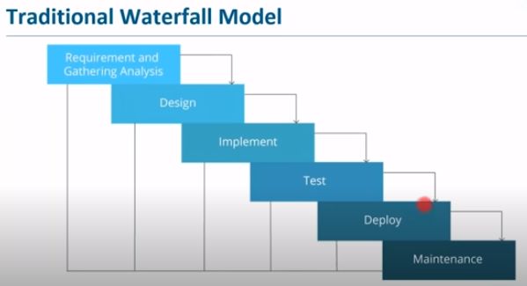

Slide 4
Build include compliation,unit testing ,packaging .
Deployed on test server for testing and then on production server for release.
After release the application is monitor.

Slide 5
Explain in brief the waterfall model.
Various stages
Linear and sequential approach

Slide 6
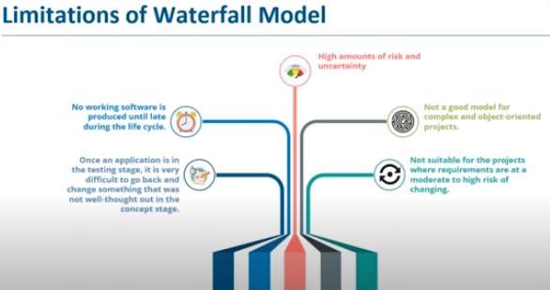

Slide 7
Difficult to do changes
Difficult to debug the the error at late stages.
Time consuming
no deliverable , it is in late stage of life cycle.
Not good for complex and object oriented project.
Chances of change in technology

Slide 8
Drawback:
Change is difficult to do
Software delivery is at the end of cycle
I

Slide 9
Agile Methodology

Slide 10
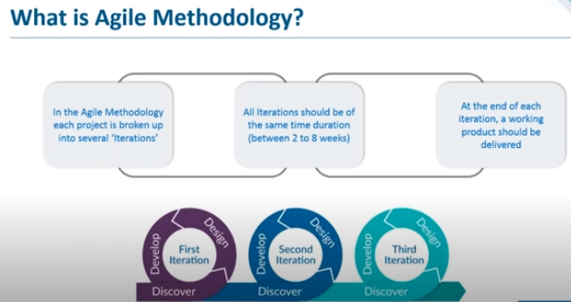

Slide 11
Continuous iteration of dev and testing throughtout the life cycle of soft devlopment.
Dev+testing→release of iteration (working product)

Slide 12
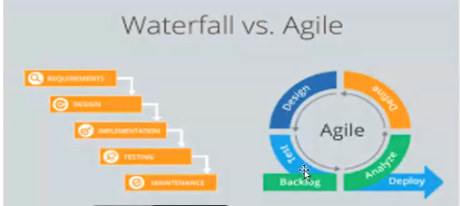

Slide 13
Analyze→plan→design→build→test→deploy
Each iteration will return deliverable product
Once the final testing is done it will be deployed in prod server.
Devlopment is continuous but deployment is not .
Deployment is linear and manual where as dev is continuous.

Slide 14
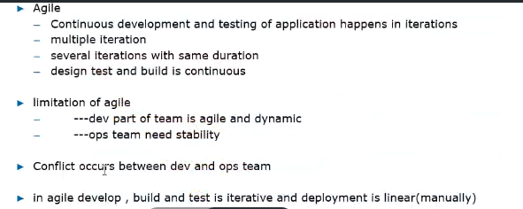

Slide 15
Solution is devops
In agile dev and testing is continuous but when we talk abt the deployment it is not continuous. For example the code working on developer laptop but not in production enviroment. Developer wants the agility where as operation team wants stability. To overcome this devops came into picture .ops ream take care of app deployment,server maintenance,monitoring etc.

Slide 16
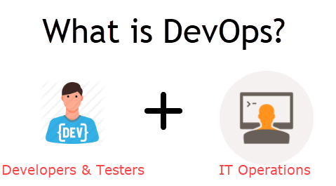

Slide 17
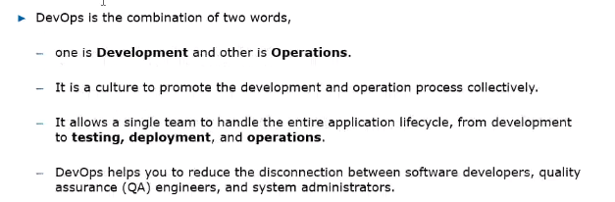

Slide 18
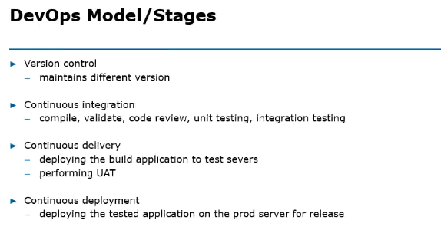

Slide 19
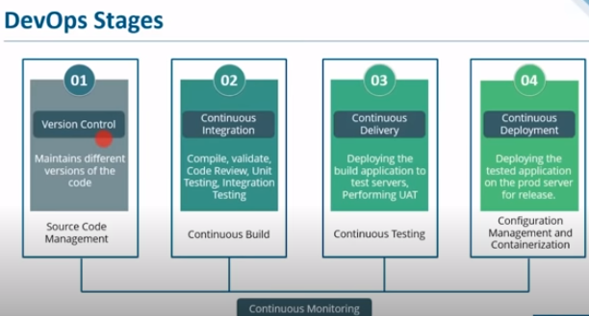

Slide 20
Version control-GitHub(SCM)
Integration—Jenkins,Building the application , compli,va (continuous build)
Continuous Delivery (continuous testing)—once the build is done jenkins will deploy the app on test server, for unit testing ,UAT, functional once done
Continous Deployment (Configuration mgt and containerization)—tested build will be deployed on prod server,maven ,gradle,

Slide 21
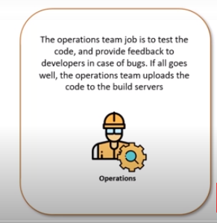

Slide 22
Docker/Kubernate –Containerization orcheistration platform
Puppet and ansible-configuration mgt
s/w testing –selenium
Integration –jenkins
Nagios-continuous monitoring

Slide 23
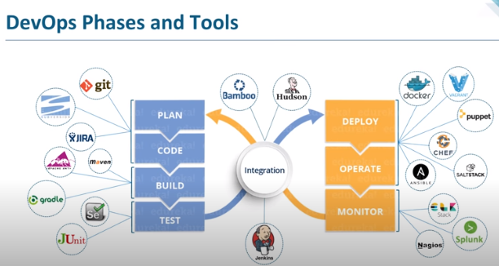

Slide 24
The tested build is deployed on prod enviroment
Opertaion-using the sw, to see the traffic, execution,
Monitoring the functionality ,if not send the feedback and again start from plainning.
Life cycle is autonated throght tool.
Docker is a container management service. The keywords of Docker are develop, ship and run anywhere. The whole idea of Docker is for developers to easily develop applications, ship them into containers which can then be deployed anywhere.
Docker will give the tool to the op team.developer will put the code inside docker and oush it to the next phase.

Slide 25
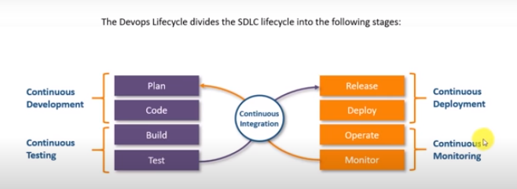

Slide 26
Ex, devloper devlopes some code for web app . We need to deploy it on application server to make it availible to the end user.
UI dev,backend dev,db developer .will keep their code at central location called as source code mgt tools.
Git—version controlling
Github-source code management tool
Convert code into artifact jar/war/rar format for this we need build tool such ant,gradle,maven etc
Artificatewill be loated on server ex tomcat
Quality check –static code anysis sonartube
To make a repository , backup we use nexas
Automate the things we use jenkins

Slide 27
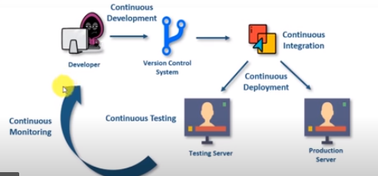

Slide 28
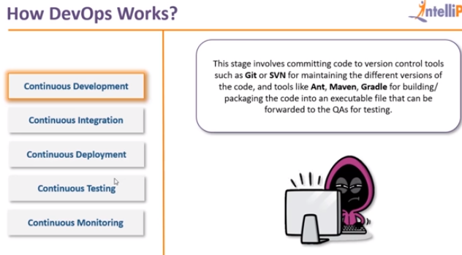

Slide 29
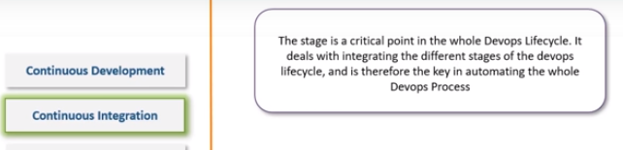

Slide 30
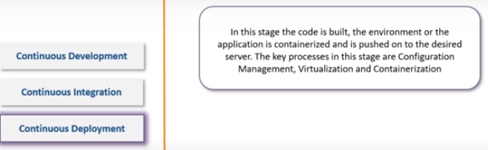

Slide 31
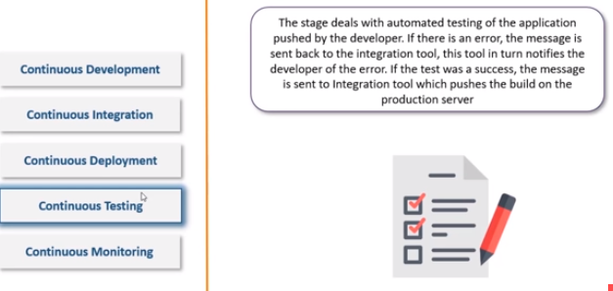

Slide 32
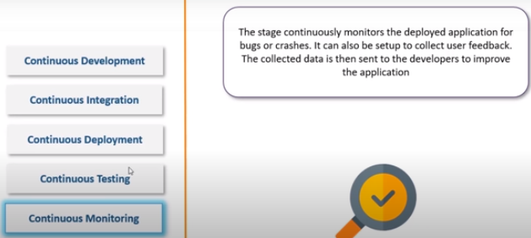

Slide 33
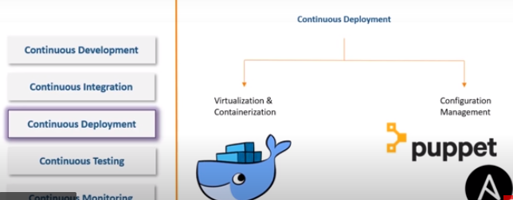

Slide 34
CON DEPLOYMENT –
Visualization & containerization:prb of sw running on differ platforms is solved by containerization, container will wrap the code with all.if we run the container on any sys it will run.container is the executable form of os
Conf mgt:puppet ansible,no need to install the sw if there is sw comatibility issue ,
Docker provides container

Slide 35
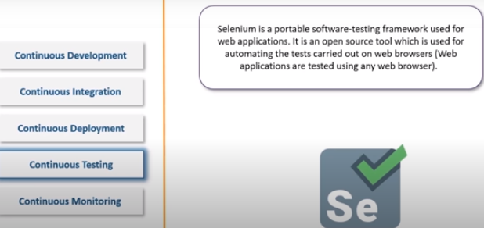

Slide 36
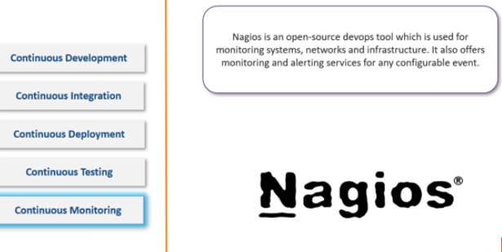

Slide 37
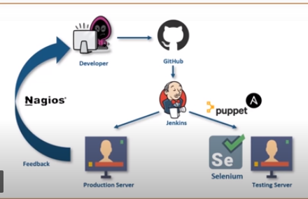

Slide 38
https://intellipaat.com/community/37506/what-are-the-stages-of-the-devops-lifecycle

Slide 39
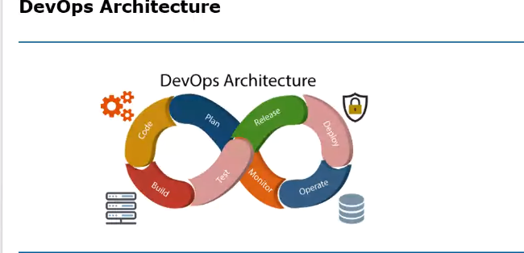

Slide 41
PLANNING: requirement analysis
Code: code version management , source management. Tools used git, git hub
Build: compilation, validation, pkging unit testing, integration testing tool used maven ,gradle,ant etc.
Test: build application is deployed in test environment for testing such as unit , end user,function testing , selenium JUNit,
Deploy and operate: deployed on production environment.docker,puppet,chef etc.
Monitor-continous monitoring is done nagios,splunk
Integration:heart of devops,jenkins. integration:building the application continuously if it has changed.compliing,packaging . Jenkins.any changes in the code in shared repos , jenkins will pull the changes and build the changes . build will be deployed on test server.deploy it on prod server and then finally by tools such as nagios,Splunk

Slide 42
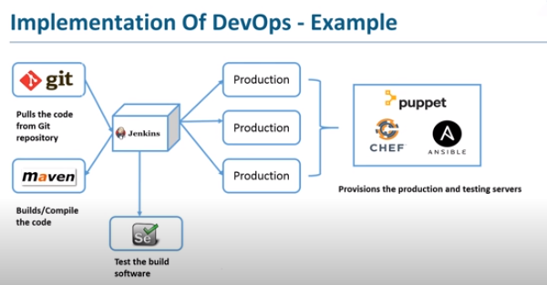

Slide 43
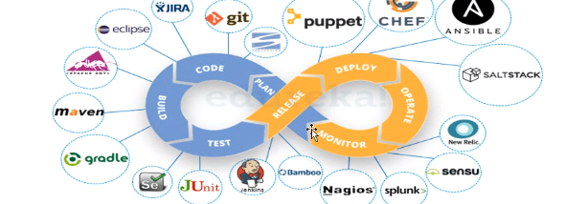

Slide 44
Test and prod server are manged by chef,puppet,ansible
https://www.javatpoint.com/devops-tools

Slide 45
Stages in devops
Version controlling—mutiple devloper is working on the same application to know abt the which dev has made which commit and at what time if any issue then how we will revert to the dev .managing the source code. Like git
Continuous integration:building the application continuously if it has changed.compliing,packaging . Jenkins
Continuois delivery Jenekins .build is deployed on test server for testing User acceptance testing for that we use tools like selenium for automation testing
Continuous deployment: Configuration mgt.

Slide 46
New code→continuous integration server will pull and make a build 1→2
2→3 build will be deployed on test server
3->4 continus deplyment
Monitor by continous monitiing tool such as nagios
Continous deployement is not advisable bcoz before releasing we want o do multiple checks , testing , we don’t want it shd be automated so we go for manual deployment tool such as puppet,docker ,chef etc.

Slide 47
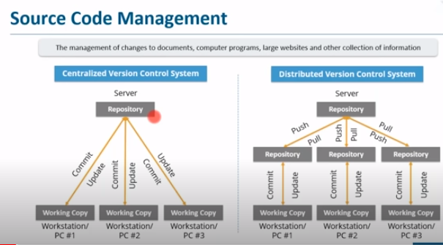

Slide 48
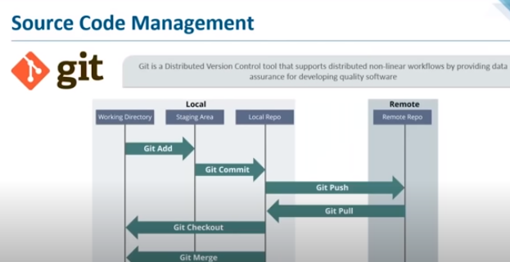

Slide 49
Git command
Git version
======Directory Command==================
mkdir <folder name>
cd <path of the directory>
=====--------------------------------------
Dell@Admin MINGW64 /g/ManishaGit
$ mkdir Myprojct
Dell@Admin MINGW64 /g/ManishaGit
$ cd Myprojct
Dell@Admin MINGW64 /g/ManishaGit/Myprojct
$
=========================================
To convert directory into local repository
Dell@Admin MINGW64 /g/ManishaGit/Myprojct
$ git init
=============================================

Slide 50
Add and Commit
----------------
create a file in Myprojct
example File1.txt
add some text in it
Now save the changes in staging error
Dell@Admin MINGW64 /g/ManishaGit/Myprojct (master)
$ git add File1.txt
will add the File1.txt to staging Area.

Slide 51
To add all files in the staging error use
-----------------------------------------------------
Dell@Admin MINGW64 /g/ManishaGit/Myprojct (master)
$ git add .
.-->Period
$git add File*
$ git status
To commit the files in Local Repository
---------------------------------------
Dell@Admin MINGW64 /g/ManishaGit/Myprojct (master)
$ git commit -m "First Commit"
[master (root-commit) 1aef2b1] First Commit
1 file changed, 1 insertion(+)
create mode 100644 File1.txt

Slide 52
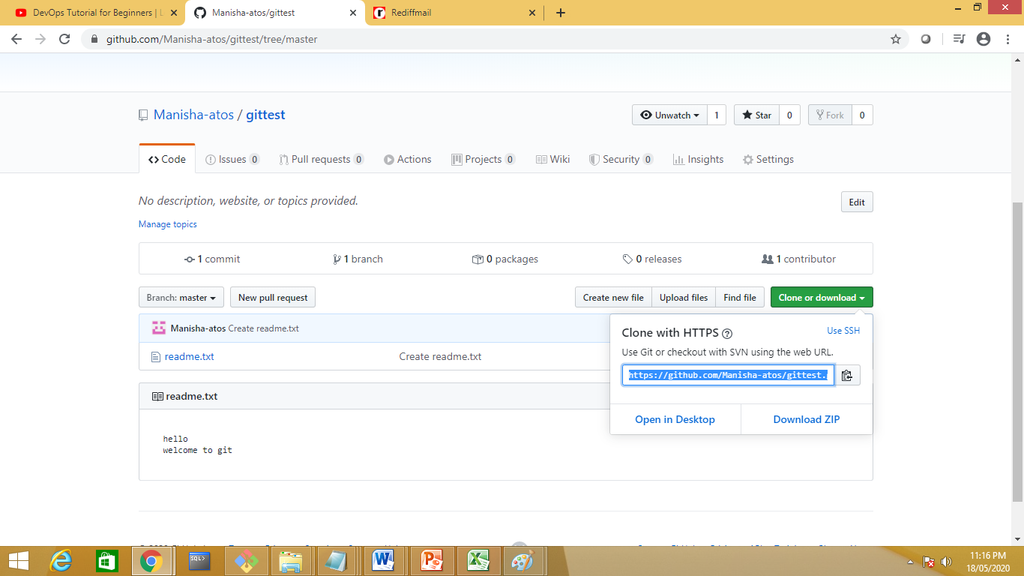

Slide 53
Dell@Admin MINGW64 /g/ManishaGit/test (master)
$ git remote add origin https://github.com/Manisha-atos/gittest.git
Will add the remote rep to locl repo

Slide 54
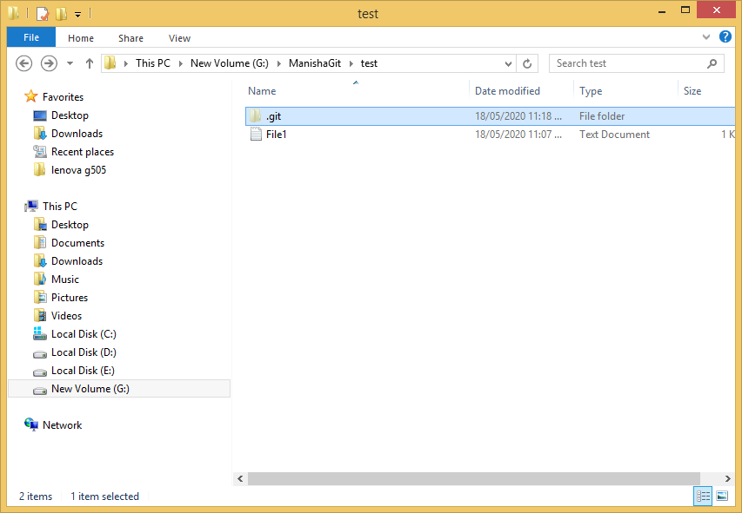

Slide 55
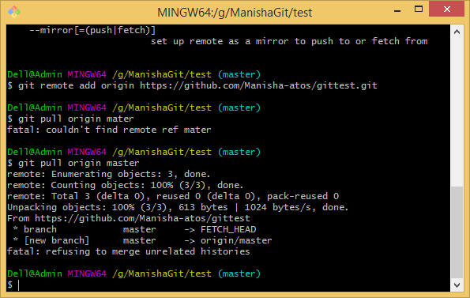
To pull from remote rep to local rep
$git pull origin master
git pull origin master --allow-unrelated-histories

Slide 56
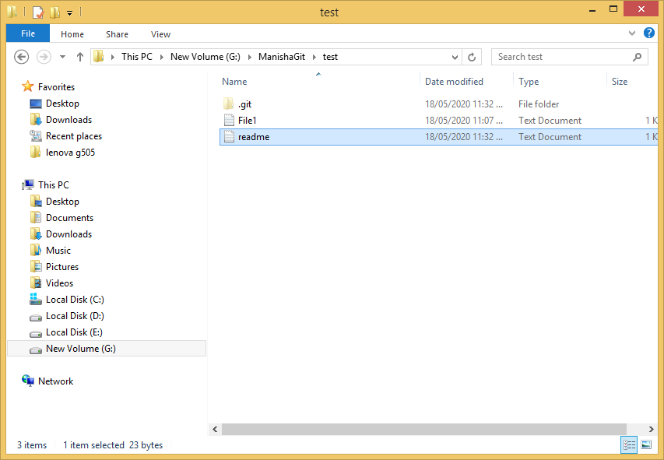

Slide 57
Local →Remote
$git push origin master

Slide 58
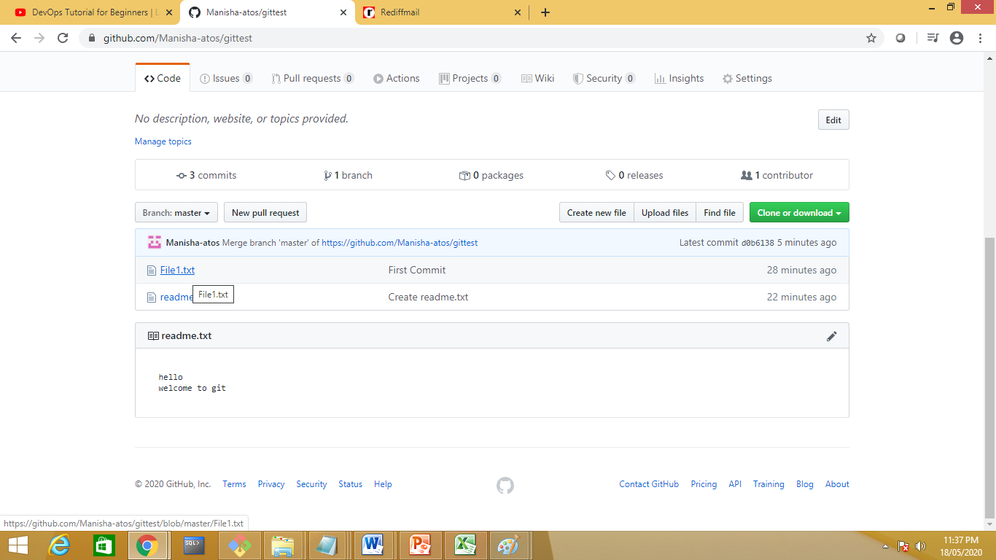

Slide 59
Maven commnd

Slide 60
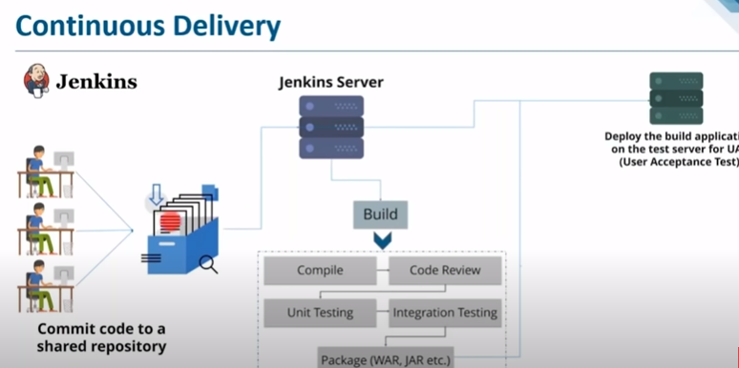

Slide 61
https://www.youtube.com/watch?v=hQcFE0RD0cQ

Slide 62
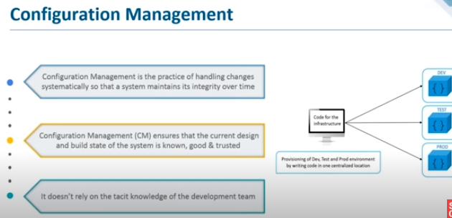

Slide 63
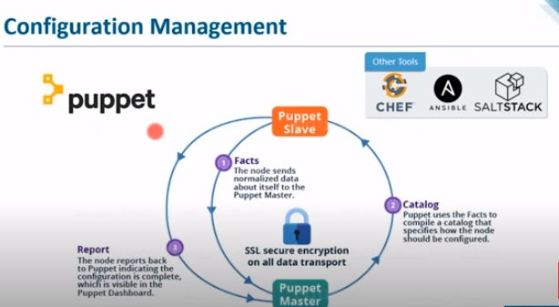

Slide 64
Introduction to Jenkins

Slide 65
Apache Maven Command(software project mgt and compilation tool base on POM –project object model)
Dependency mgt system
mvn archetype:generate
-DgroupId = com.example
-DartifactId = calc
-DarchetypeArtifactId = maven-archetype-quickstart
-DinteractiveMode = false

Slide 66
MVN package: This command is used to execute all Maven phases until the package phase. It does the job of compiling, verifying and building the project. It builds the jar file and places it in the specified folder under the specified project.

Slide 67
mvn compile: This command is used to compile the source code. It also compiles the classes that are stored at a particular target or class.
mvn clean install: This maven command helps in executing a clean build life cycle and installs build phase in the default build cycle. This build life cycles may have its build phases and inside each build, there are different build goals. Also, this ensures that the build target is being removed for a new build and adds the clean target.

Slide 68
mvn test: Maven also provides the facility of unit testing particular codes. It runs the tests using suitable testing frameworks.

Slide 69
A Build Lifecycle is Made Up of Phases
Each of these build lifecycles is defined by a different list of build phases, wherein a build phase represents a stage in the lifecycle.
For example, the default lifecycle comprises of the following phases (for a complete list of the lifecycle phases, refer to the Lifecycle Reference):
validate - validate the project is correct and all necessary information is available
compile - compile the source code of the project
test - test the compiled source code using a suitable unit testing framework. These tests should not require the code be packaged or deployed
package - take the compiled code and package it in its distributable format, such as a JAR.
verify - run any checks on results of integration tests to ensure quality criteria are met
install - install the package into the local repository, for use as a dependency in other projects locally

Slide 70
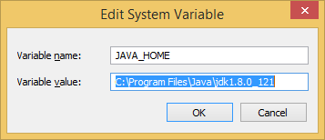
Set JAVA_HOME to C:\Program Files\Java\jdk1.7.0_60

Slide 71
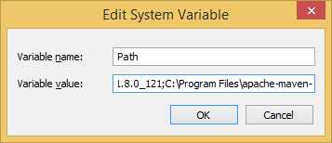
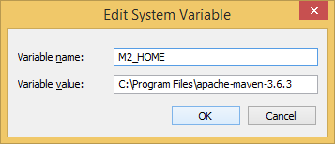
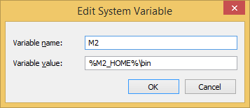
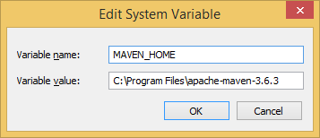
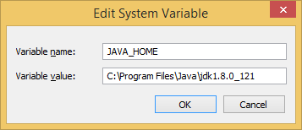
Set Maven Environment Variables

Slide 72
Mvn –v
Create
Mvn pac
Mvn clean install
Mvn validate
Mvn compile
Mvn build
Mvn test

Slide 73
Jenkins
2 ways to run Jenkins
Standalone
With web server such as tomcat
https://updates.jenkins-ci.org/download/war/
standalone installation
1.download Jenkins file
for standalone we need jdk1.8
for tomcat any version
2.copy pate it in drive
3. start a cmd and run the command
Java –jar Jenkins.war

Slide 74
Java –jar Jenkins.war --httpPort=9090
Manisha Jenkins pwd
https://www.guru99.com/jenkins-github-integration.html

Slide 75
Check for th github plugin in jenkins
Git integration
Github integartion
Maven integration
Githubapi

Slide 76
Create a new gitcmd job to excute the git command

Slide 77
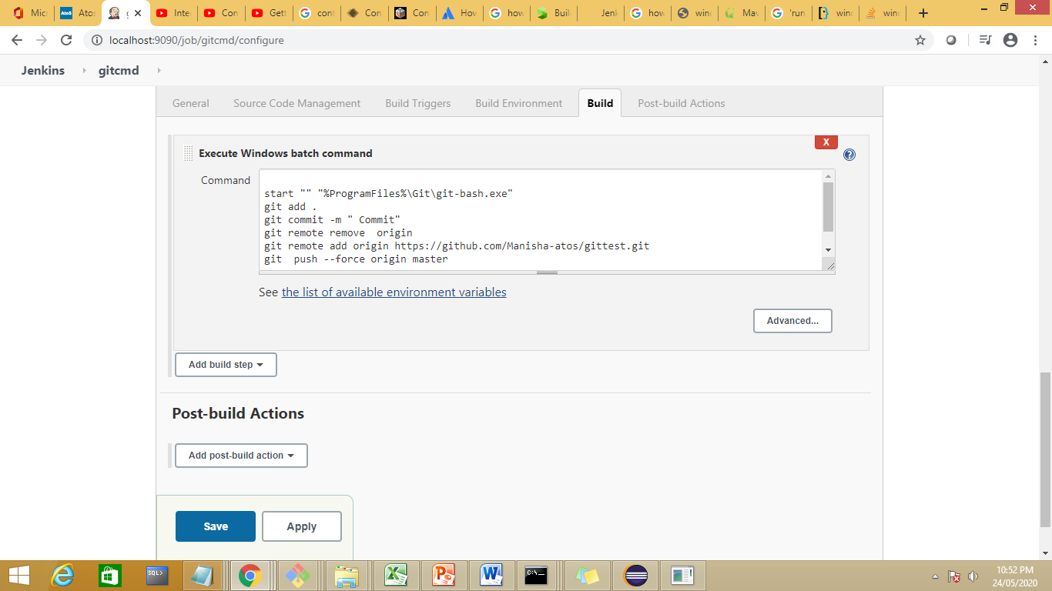

Slide 78
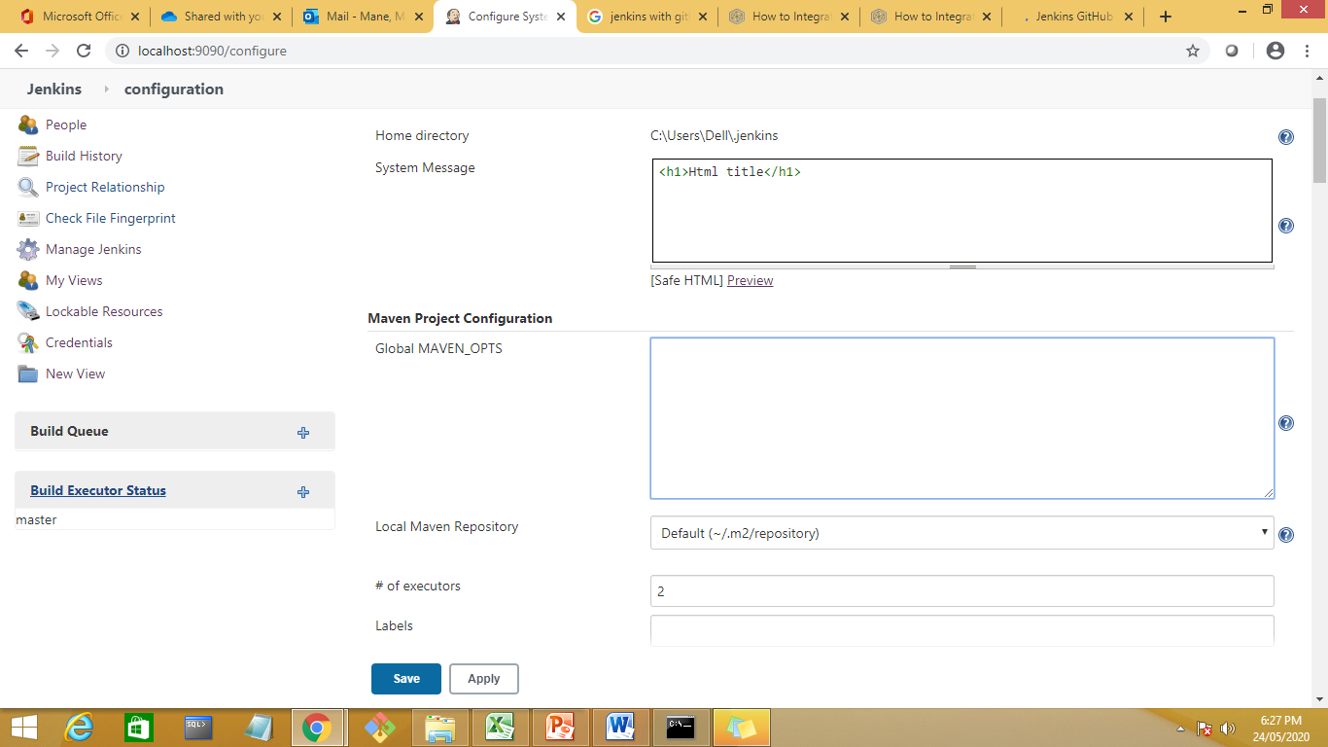

Slide 79
Create a new job to push the data from remote repositry to jenkins

Slide 80
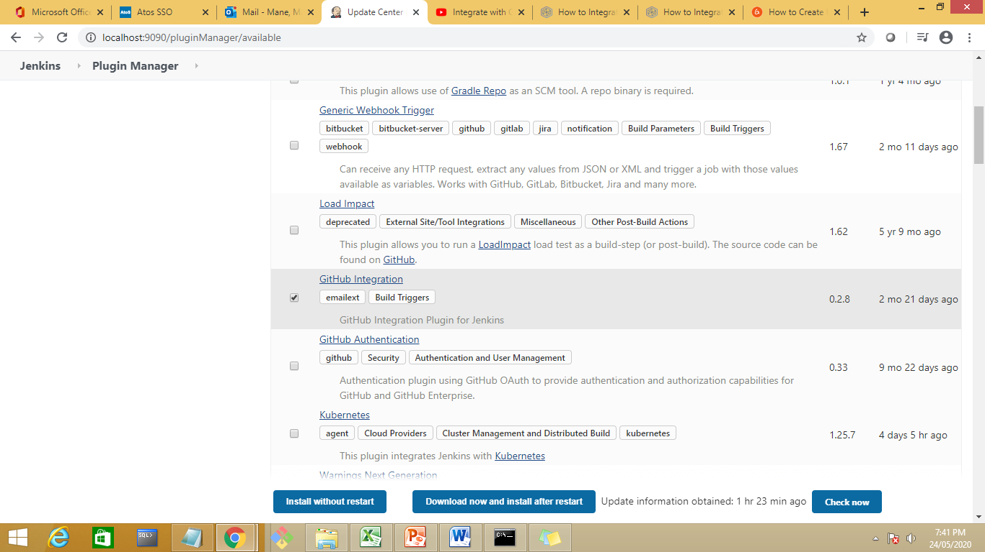

Slide 81
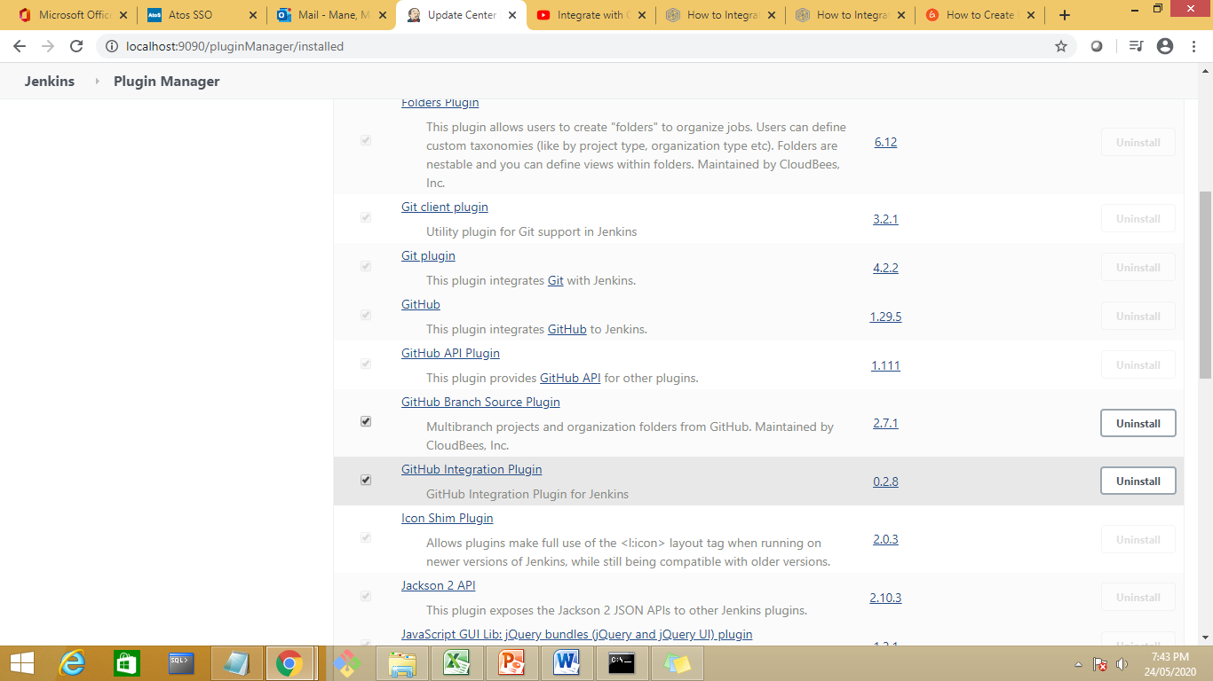

Slide 82
Download now and install now if not available
Install git plugin
Restart the jenkins

Slide 83
Code management from git to jenkins.
Create a new job

Slide 84
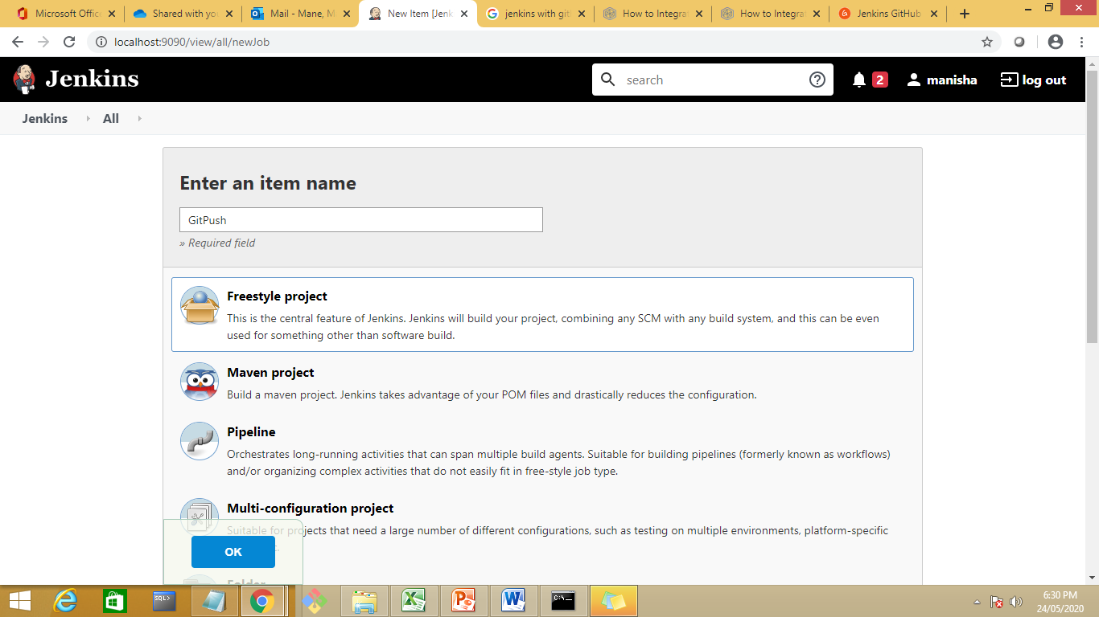

Slide 85
In the screen you see now, scroll down a little to the Build Triggers section. We're going to make sure that this Jenkins job runs only when someone pushes a change in the GitHub repo. You can configure other actions, like when someone creates a pull request. But for simplicity's sake, we'll stick with the push action only. Of course, you can always run the job manually, but that's not ideal. So, choose the GitHub hook trigger for GITScm polling option.

Slide 86
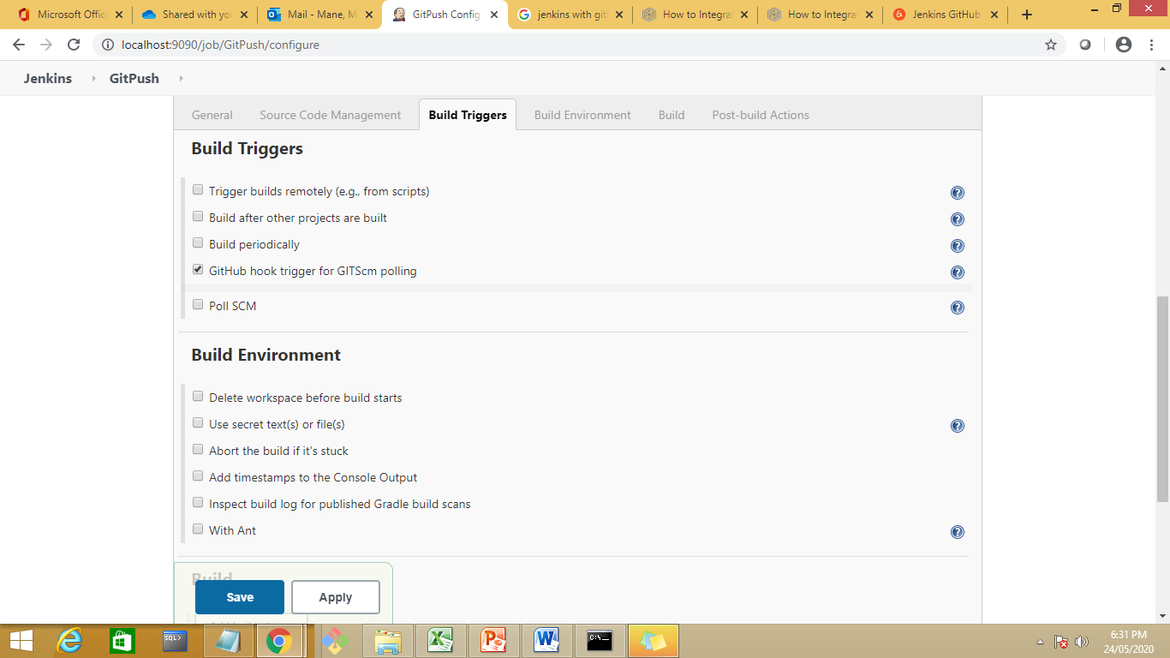

Slide 87
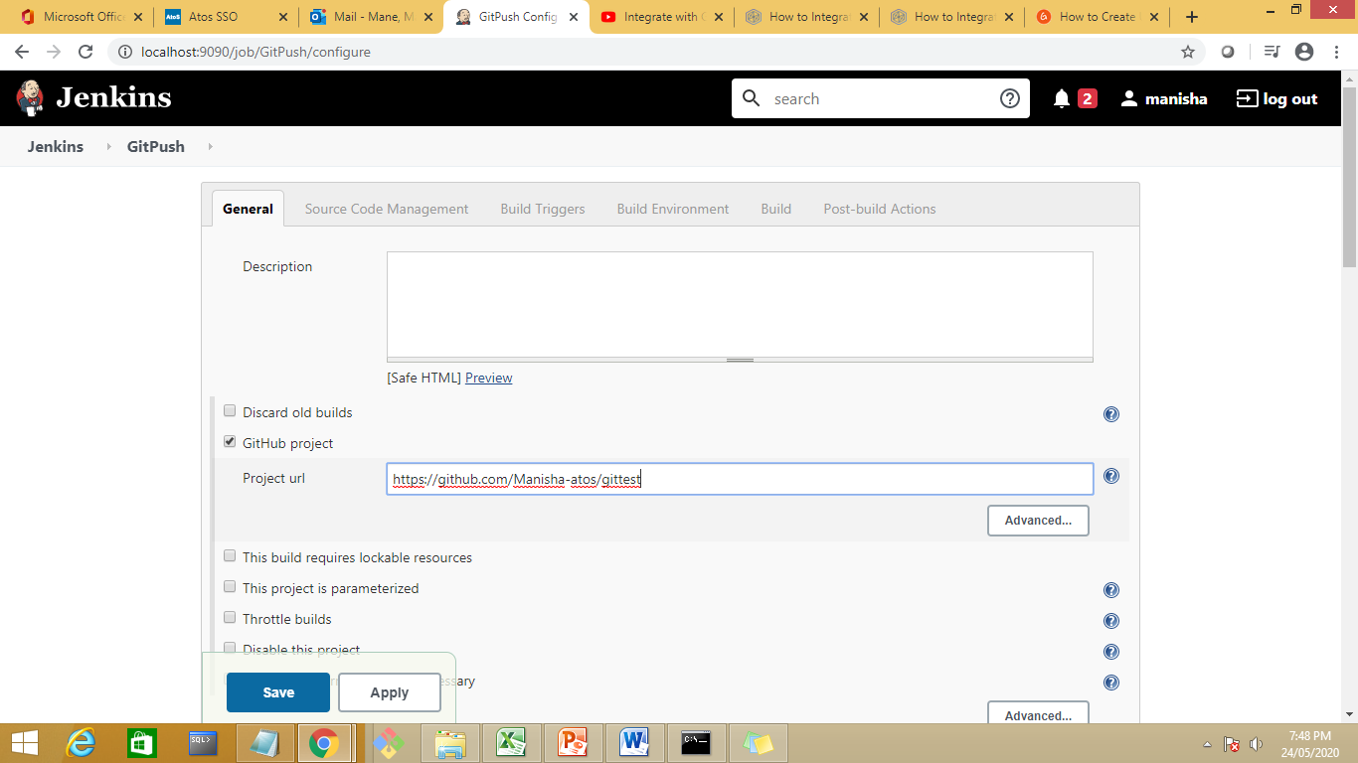

Slide 88
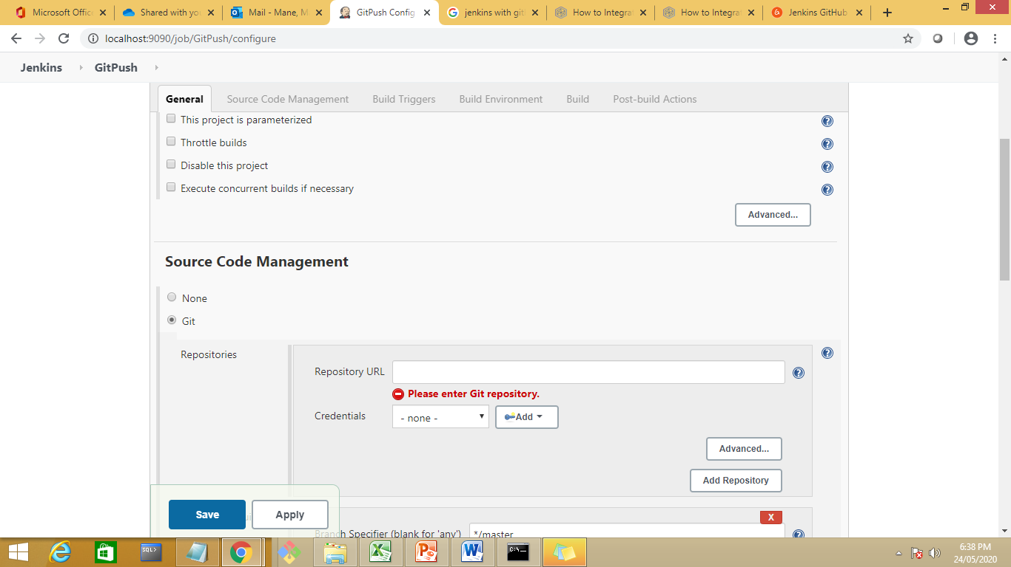

Slide 89
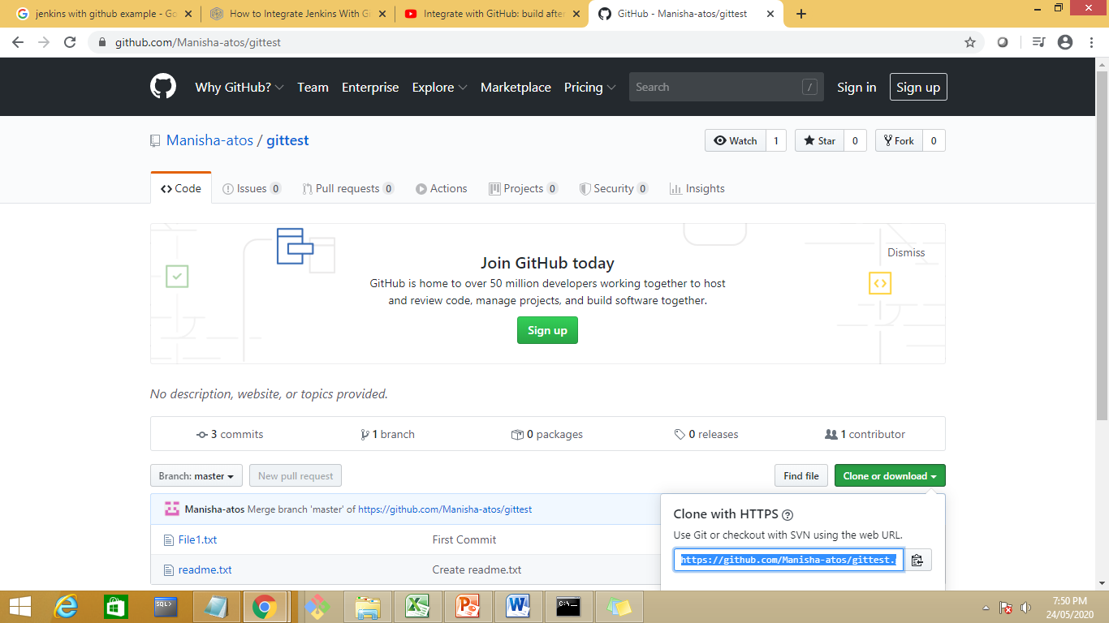

Slide 90


Slide 91
SPECIFY THE BRANCH default is master.
Build trigger-specify an event whoch will notify jenkins when to start push with github

Slide 92


Slide 93


Slide 94
Save the job

Slide 95
To tell gihub abt jenkins go to repository
Github repository→settings →webhook→Add webhook

Slide 96


Slide 97


Slide 98


Slide 99

Chanhe local host to ip address

Slide 100
Add webhook

Slide 101
Do some changes in repos

Slide 102


Slide 103
Add new file in repository as FIle3.txt
Commit the changes and build the jenkins job

Slide 104


Slide 105
Jenkins with Maven
https://www.google.com/search?rlz=1C1OKWM_enIN897IN897&biw=1366&bih=657&ei=5pXKXtfQDYrXz7sP5-Kx4A4&q=how+to+use+git+add+command+in+jenkins&oq=how+to+use+git+add+command+in+j&gs_lcp=CgZwc3ktYWIQARgAMggIIRAWEB0QHjIICCEQFhAdEB4yCAghEBYQHRAeMggIIRAWEB0QHjoFCAAQkQI6BQgAEIMBOgIIADoECAAQQzoECAAQCjoGCAAQFhAeUKamAViW2QFgl-0BaABwAHgAgAHCAYgB7xWSAQQxLjIymAEAoAEBqgEHZ3dzLXdpeg&sclient=psy-ab#kpvalbx=_LJbKXvjPIsfXz7sP9LutwAo54

Slide 106


Slide 107
Create a new project

Slide 108


Slide 109


Slide 110
Create a new job as maven project

Slide 111


Slide 112
Jenkins-manage plugin-global tool configuration--

Slide 113
Create a maven project

Slide 114


Slide 115


Slide 116


Slide 117


Slide 118
Select the path of pom.xml file

Slide 119
https://www.javatpoint.com/github-setup-for-jenkins

